Slide 1


NBA Fan Engagement CASE
CSCI E-89B Introduction to Natural Language Processing
Gordon Hew
March 4th, 2021

Slide 2
OUTLINE
Objective
Data & Approach
Quarterly Analysis
Conclusions and Recommendation

Slide 3
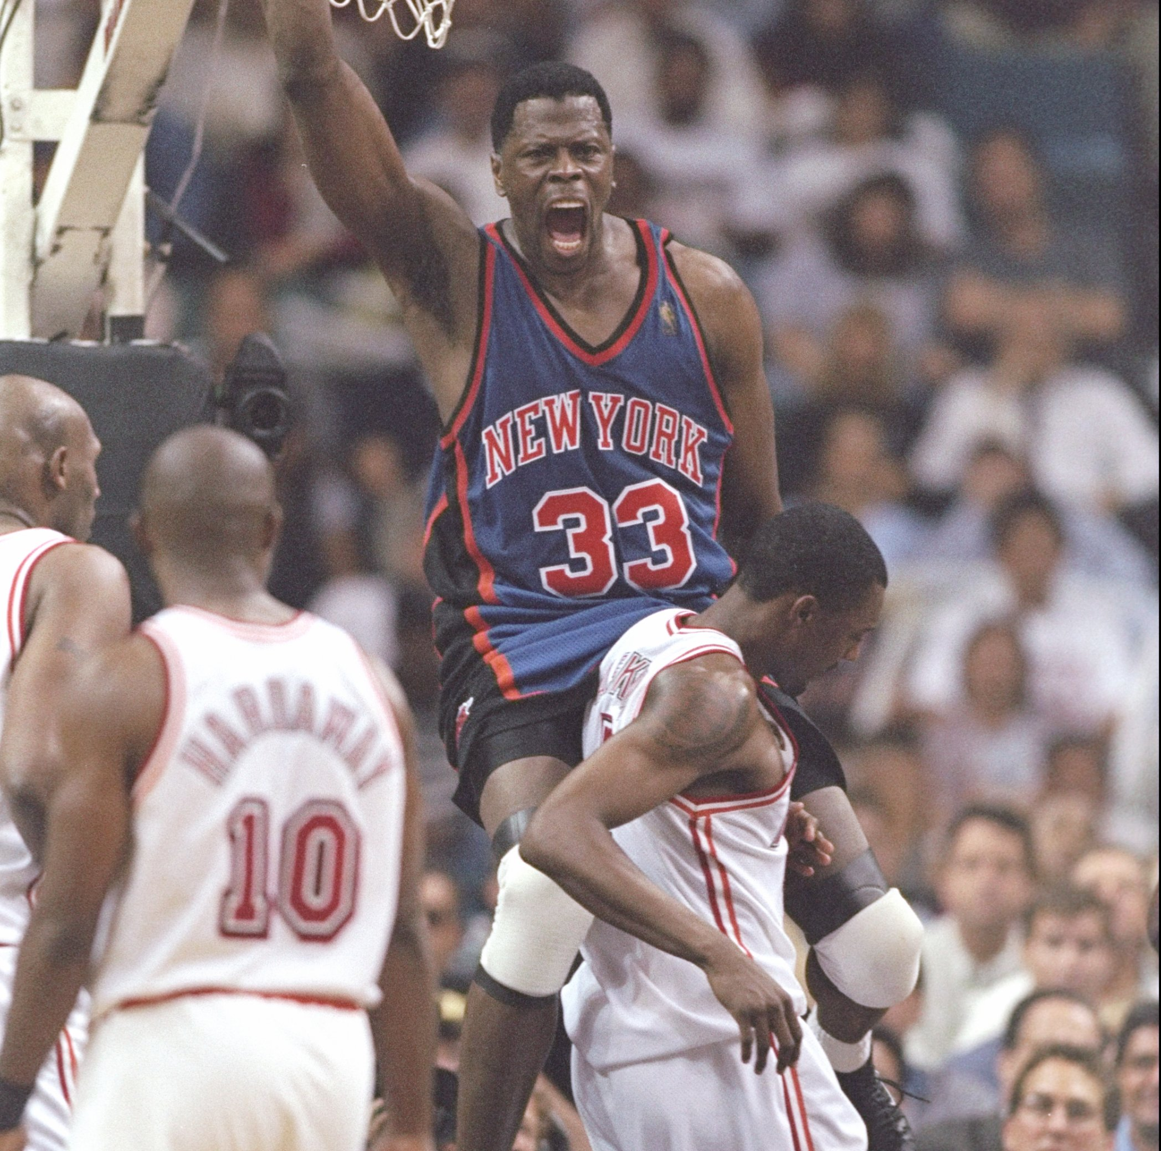
Objective
By applying NLP techniques to Twitter data, our goals are to help the Knicks:
Understand what drives mentions about the Knicks
Deep-dive into interesting terms
Observe sentiment surrounding the team
This will aid the team understand how to engage its fans in a more meaningful way in the future.

Slide 4
Data and Approach
Data
Approach
5,217,355 Tweets associated by Team
1-year of data: Oct 2019 to Oct 2020
Tweets are composed of:
document ID - any identifier of the tweet
text data - can contain a wide variety of data: normal text, emojis, contractions, non-ascii characters
creation date
Prepare raw data for text processing
For each quarter - sample 5% of the data, ~30-50k tweets a quarter -> ~1.5-2.5k sample set
Apply NLP techniques:
Word frequency counts
Word associations
Sentiment analysis

Slide 5
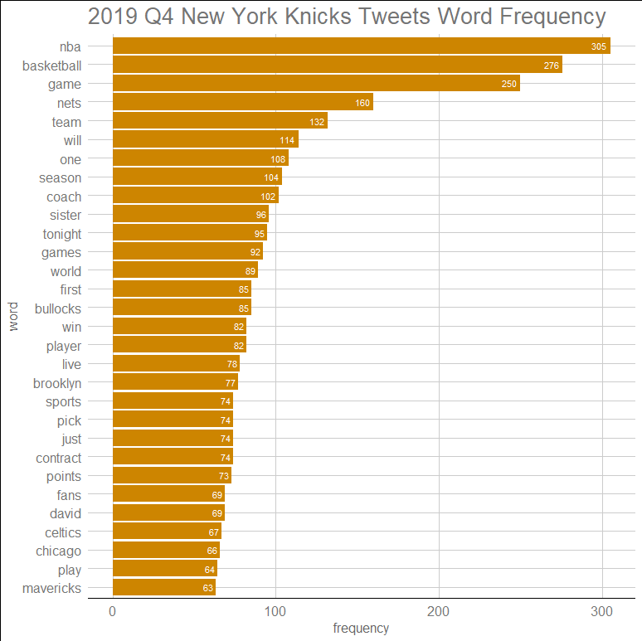
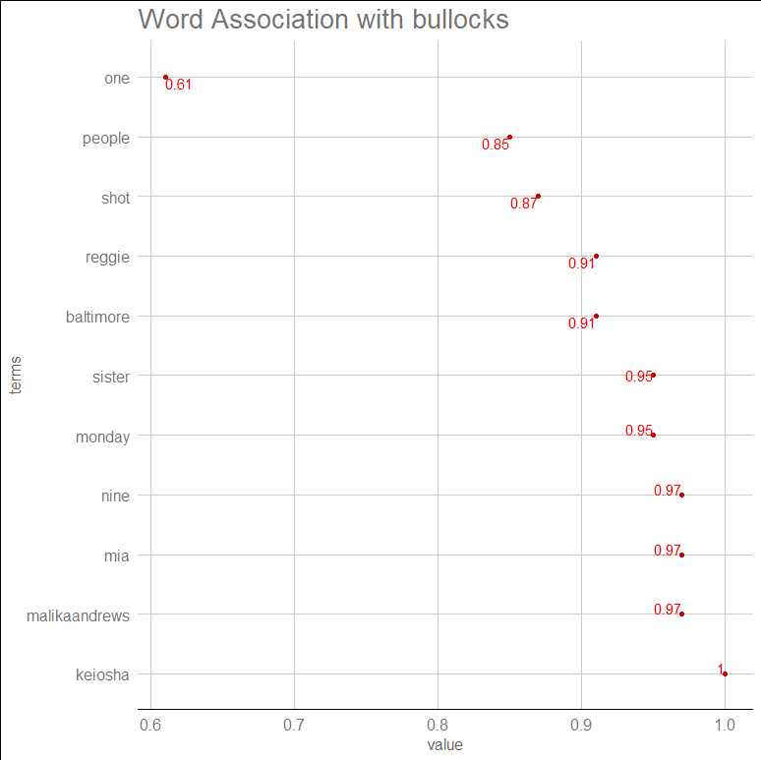
2019 Q4 - New York Knicks: term Analysis

Slide 6
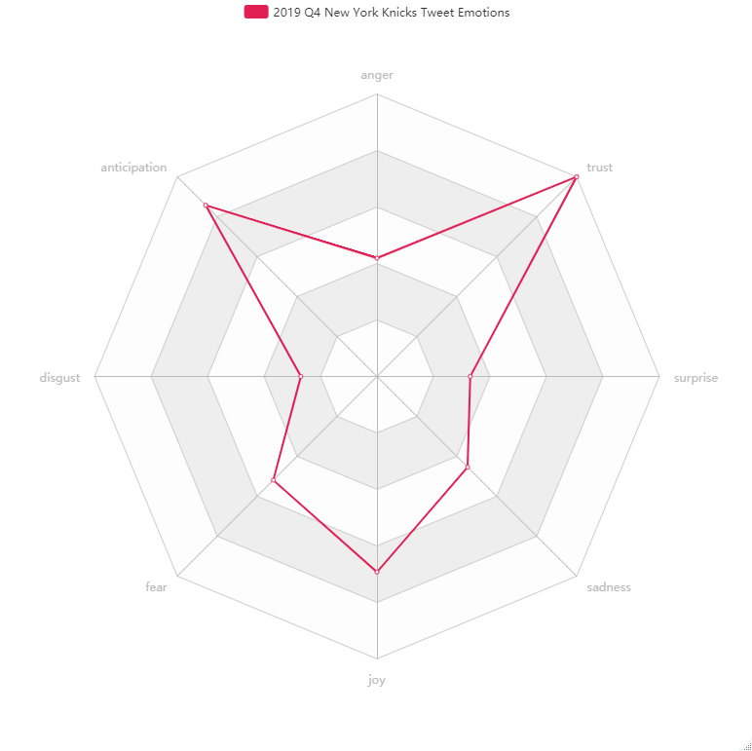
2019 Q4 - New York Knicks: Sentiment Analysis
Sentiment | Count
Negative | 837
Positive | 1072
Emotion | Count
Anger | 457
Anticipation | 935
Disgust | 294
Fear | 566
Joy | 755
Sadness | 495
Surprise | 350
Trust | 1090

Slide 7
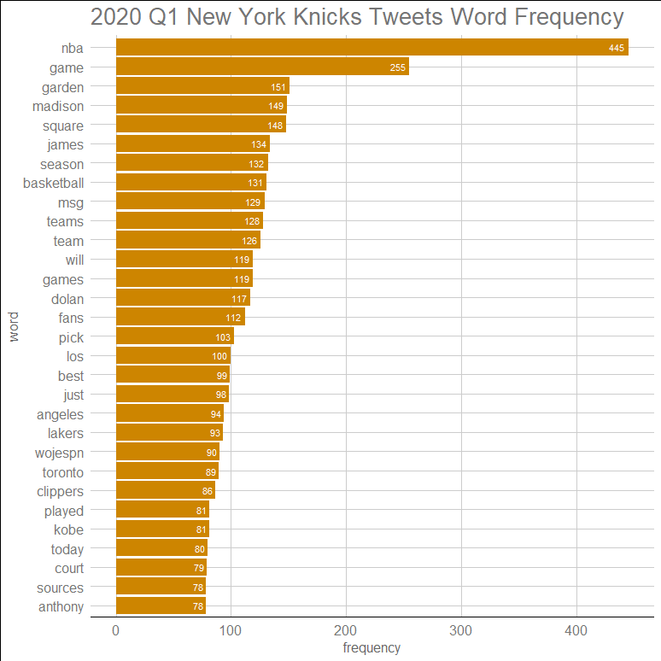
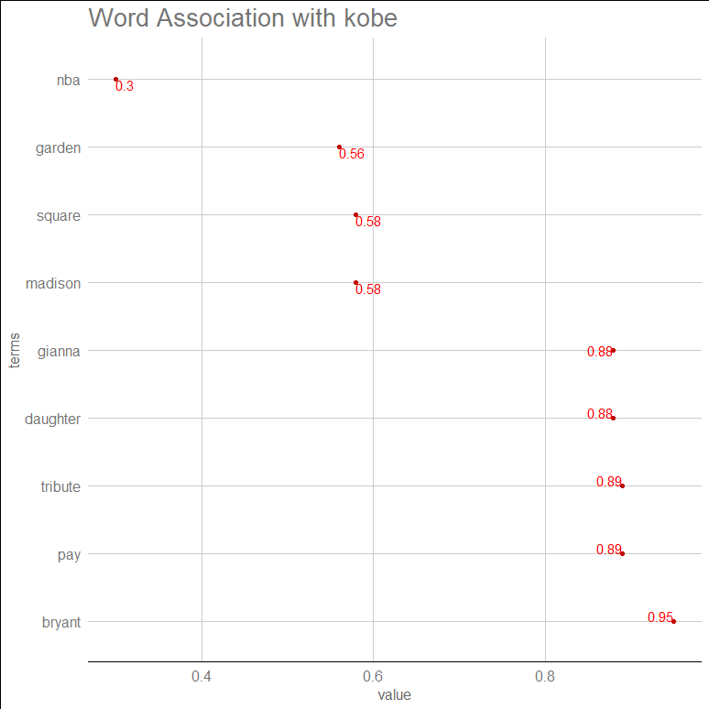
2020 Q1 - New York Knicks: term Analysis

Slide 8
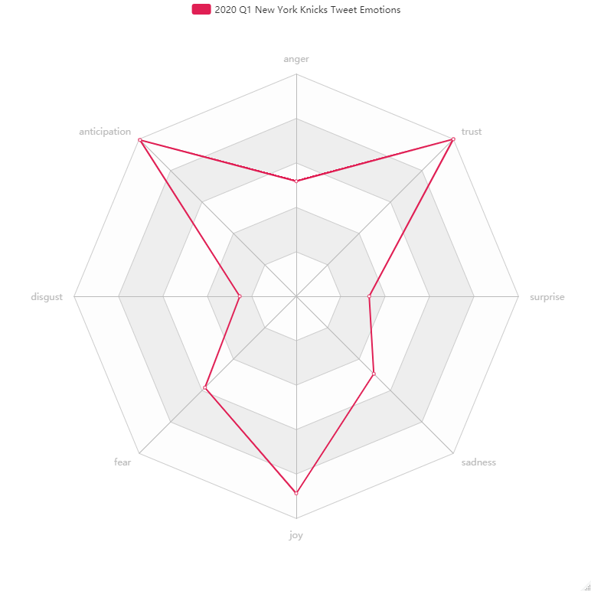
2020 Q1 - New York Knicks: Sentiment Analysis
Sentiment | Count
Negative | 787
Positive | 1339
Emotion | Count
Anger | 596
Anticipation | 1145
Disgust | 293
Fear | 669
Joy | 1021
Sadness | 568
Surprise | 378
Trust | 1151

Slide 9
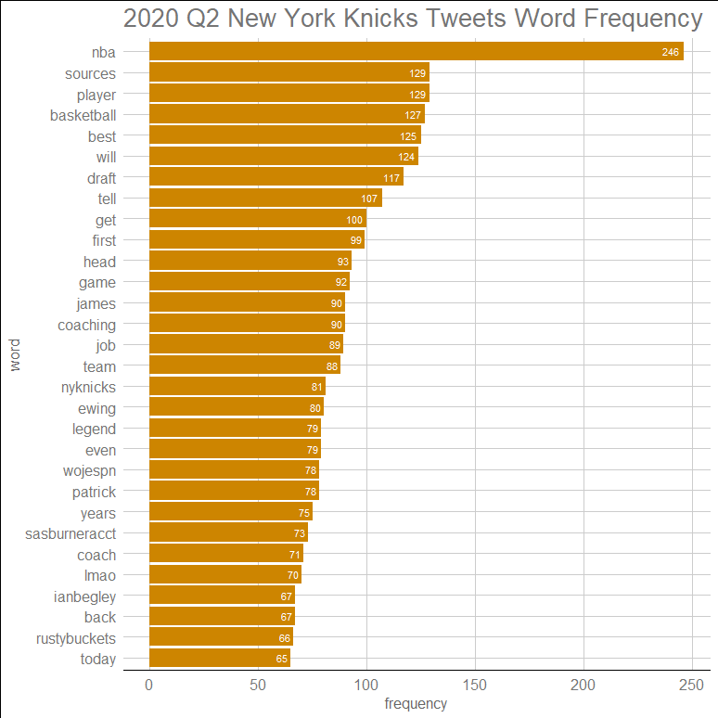
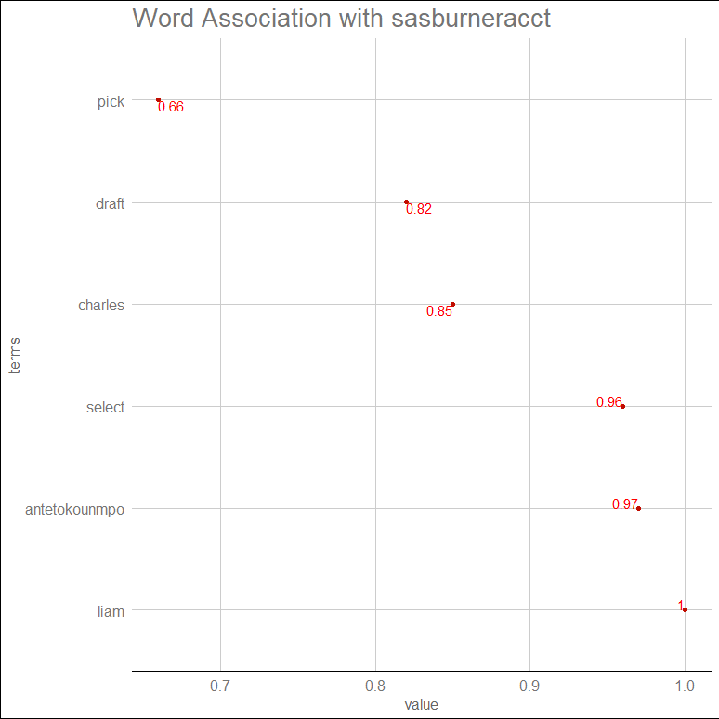
2020 Q2 - New York Knicks: term Analysis

Slide 10
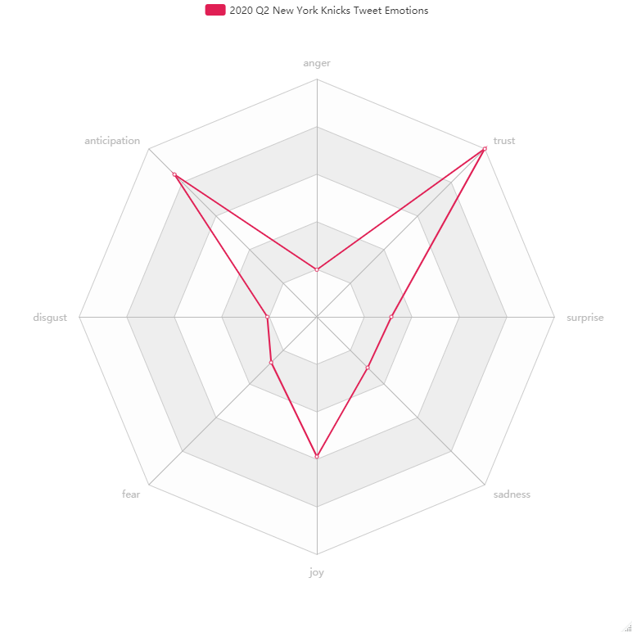
2020 Q2 - New York Knicks: Sentiment Analysis
Sentiment | Count
Negative | 393
Positive | 890
Emotion | Count
Anger | 194
Anticipation | 829
Disgust | 204
Fear | 266
Joy | 576
Sadness | 296
Surprise | 307
Trust | 979

Slide 11
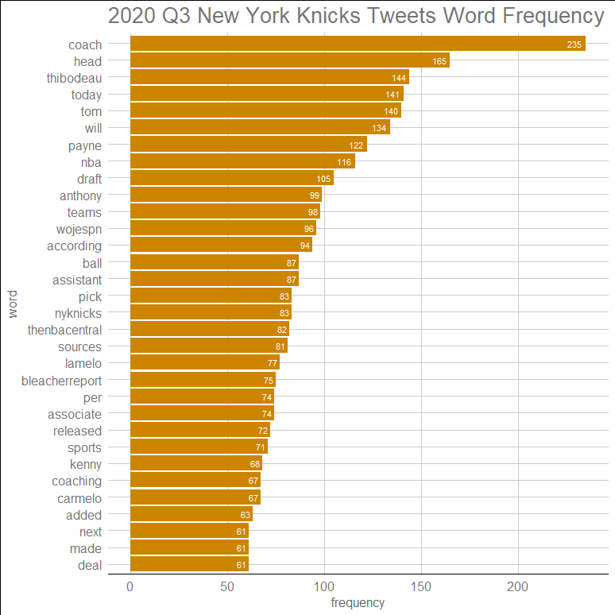
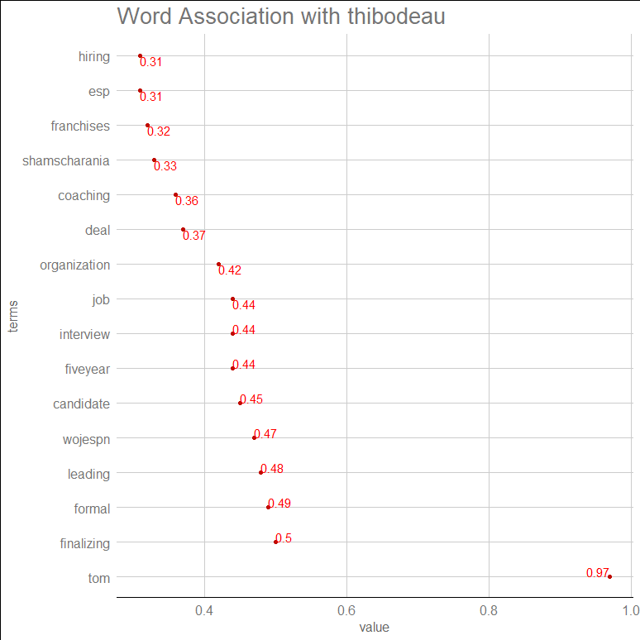
2020 Q3 - New York Knicks: term Analysis

Slide 12
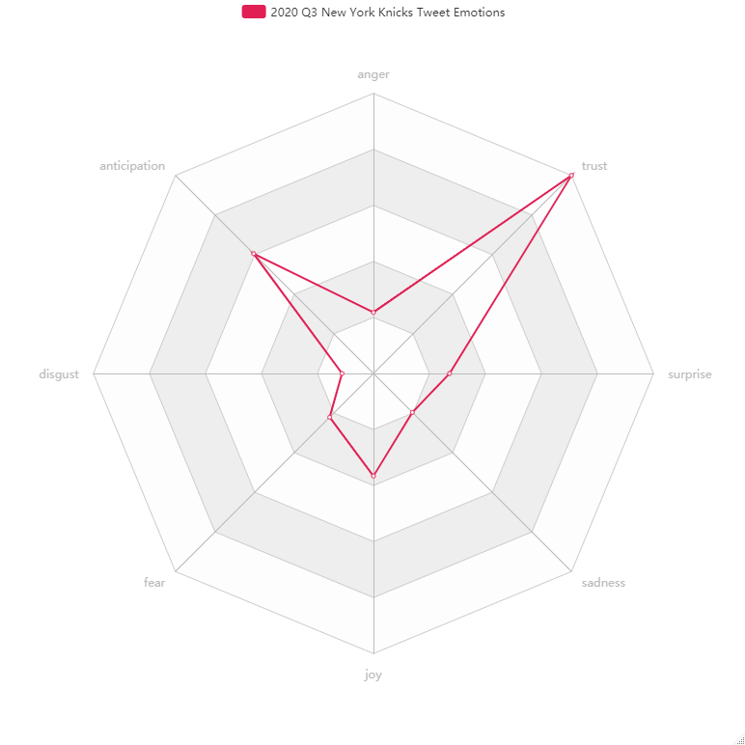
2020 Q3 - New York Knicks: Sentiment Analysis
Sentiment | Count
Negative | 412
Positive | 744
Emotion | Count
Anger | 212
Anticipation | 588
Disgust | 109
Fear | 215
Joy | 356
Sadness | 191
Surprise | 264
Trust | 972

Slide 13
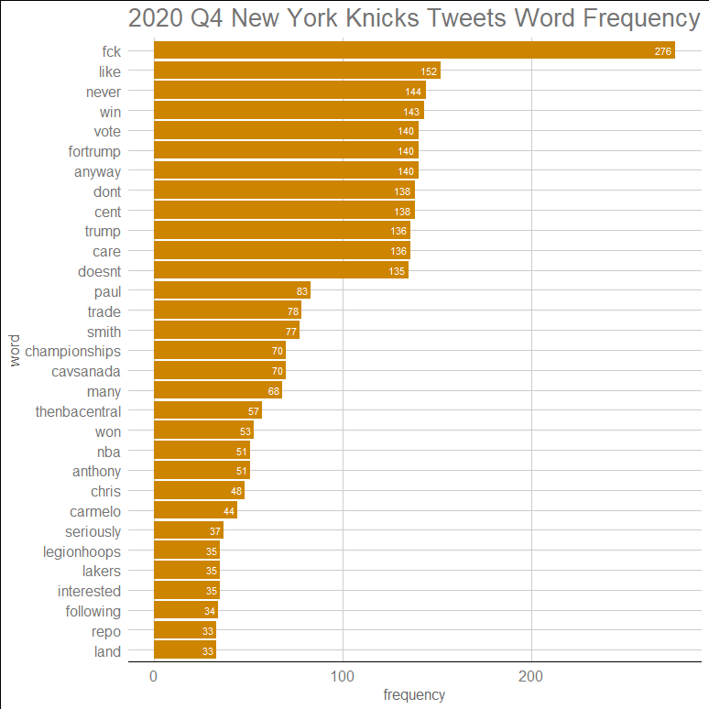
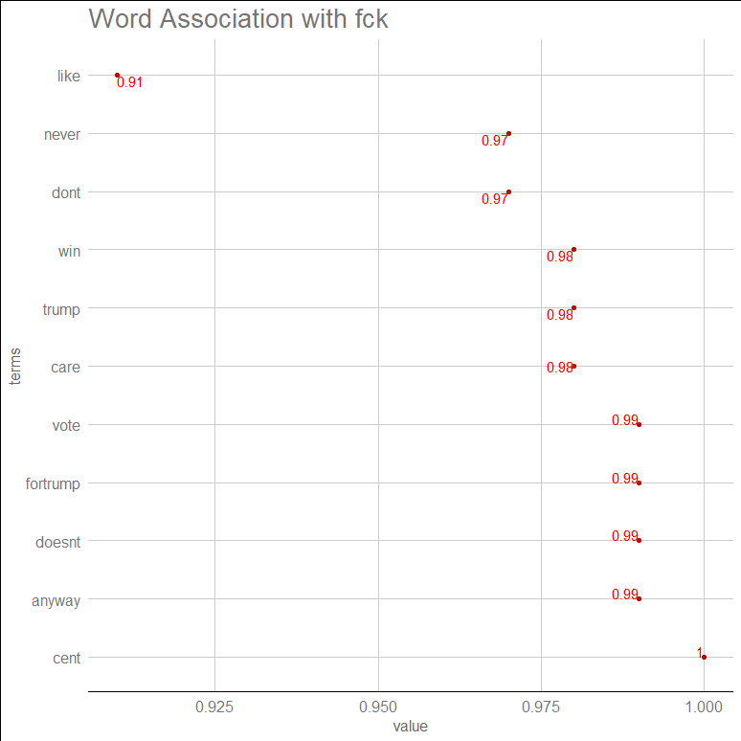
2020 Q4 - New York Knicks: term Analysis

Slide 14
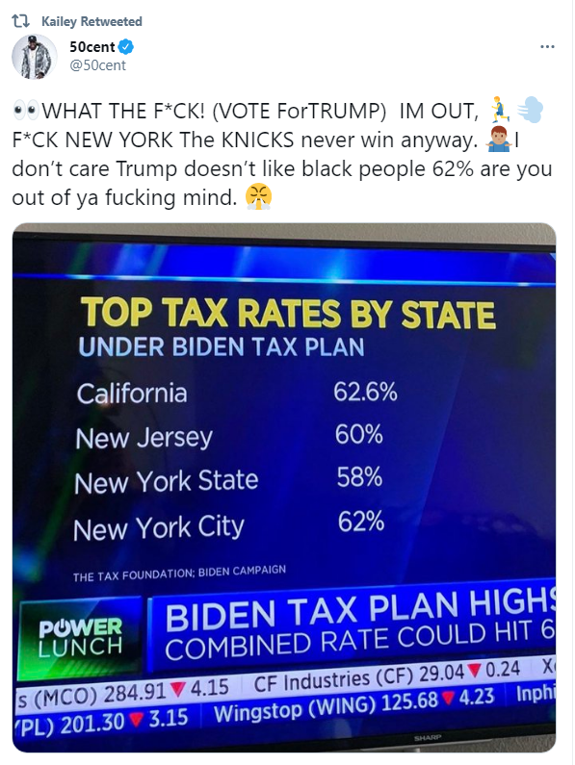
2020 Q4 - New York Knicks: term Analysis (continued)

Slide 15
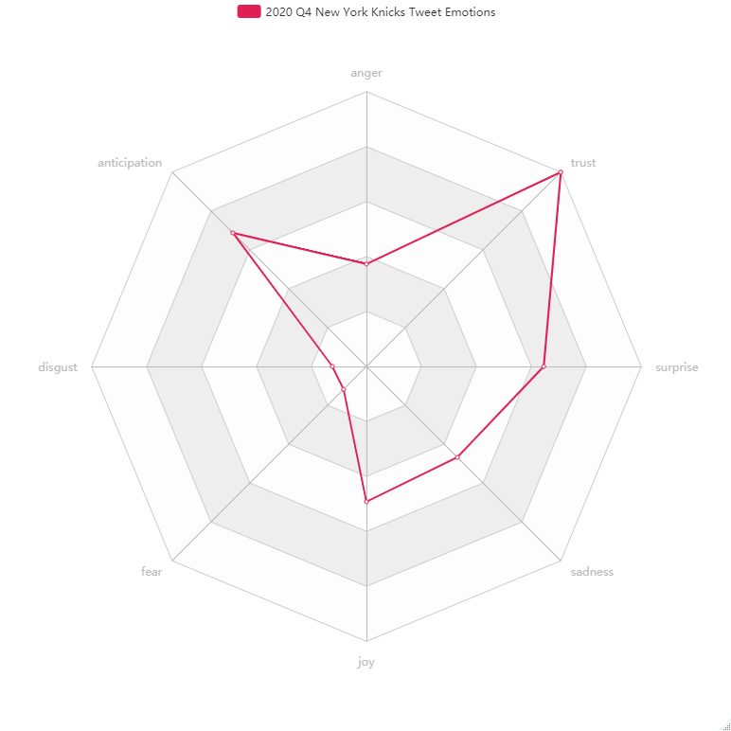
2020 Q4 - New York Knicks: Sentiment Analysis
Sentiment | Count
Negative | 63
Positive | 605
Emotion | Count
Anger | 168
Anticipation | 310
Disgust | 56
Fear | 53
Joy | 222
Sadness | 211
Surprise | 291
Trust | 451

Slide 16

Conclusions & Recommendation
Our analysis found the following:
News regarding players and coaches on and off the court often dominate
National events can dominate even tweets pertaining to the Knicks
Joyful emotional sentiment was high at the start of the regular season but fell over time
Tweets had overall more positive than negative sentiment
Influencers/Celebrities can have an outsized voice
In order to better engage fans and promote buzz, the Knicks social media team should actively engage celebrities/influencers/meme accounts while trying to promote positivity and retain joy

